Slide 1

Car Price Prediction Project

Slide 2

Abstract
The Car Price Prediction project involves developing a machine learning model to predict the prices of used cars based on various features such as the year, mileage, fuel type, and so on.
The project aims to provide a solution to the problem of accurately pricing used cars, which can be difficult due to the various factors that can influence the value of a vehicle, To achieve this goal, the project involves several steps, including data collection and preprocessing, feature engineering, model selection, and evaluation.

Slide 3
The dataset used for this project consists of information on various used cars, including their features and prices.
Overall, the Car Price Prediction project provides a practical example of how machine learning can be used to solve a real-world problem and demonstrates the importance of data preprocessing and feature engineering in developing accurate predictive models.

Slide 4
Problem Statement
The automotive industry is one of the most dynamic and rapidly evolving sectors in the world, with new car models being introduced every year. With the increase in the number of car models, it is becoming increasingly challenging for buyers to make informed purchasing decisions based on the available information, especially when it comes to pricing.
Car pricing is a complex issue making it difficult for buyers to accurately assess the value of a car and make informed decisions.

Slide 5
This lack of transparency and consistency in car pricing poses a significant challenge for buyers, particularly those with limited knowledge of the automotive industry or who are purchasing a car for the first time. It also creates a potential for buyers to overpay for a car or for sellers to undervalue their vehicles.
To address this challenge, a reliable and accurate car price prediction system is needed that can assist buyers in making informed purchasing decisions.

Slide 6
Objective of the Project
The objective of a car price prediction machine learning project is to develop a predictive model that can accurately estimate the price of a car based on various features and factors. This type of project can be useful for a variety of stakeholders, including car buyers, car dealerships, and car manufacturers.
In summary, the purpose and goal of a car price prediction machine learning project is to develop a model that can provide accurate price estimates for cars, which can benefit car buyers, dealerships, and manufacturers alike.

Slide 7
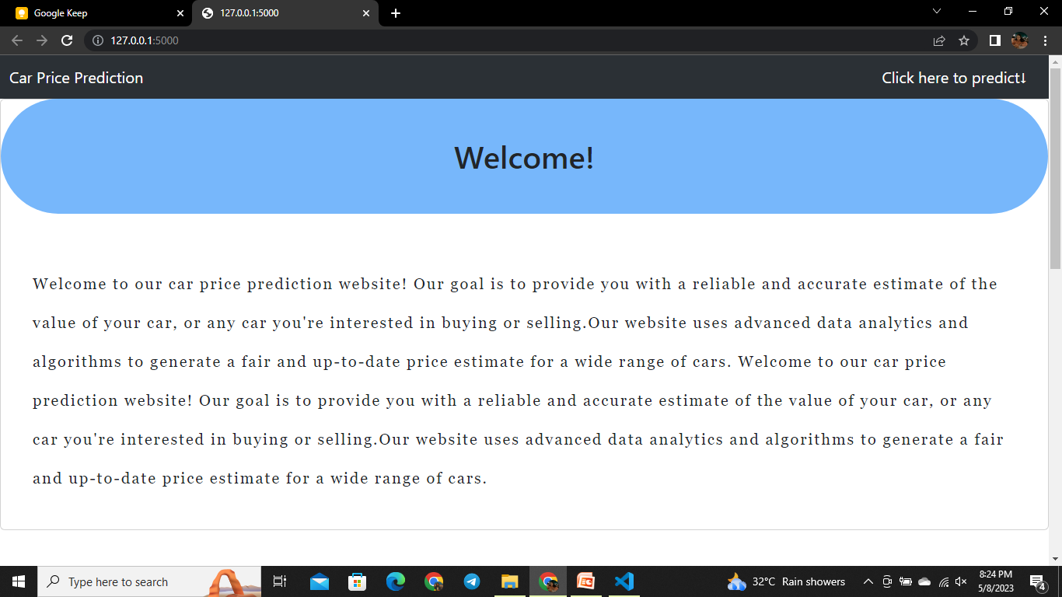
The Welcome Page

Slide 8
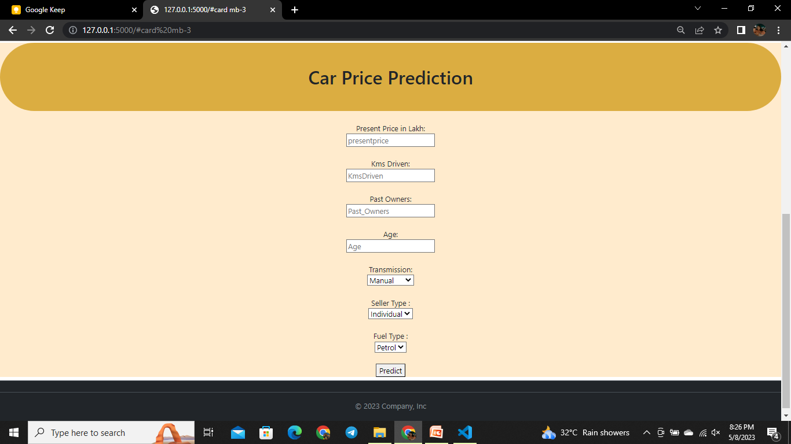
Prediction Page

Slide 9
Scope
The scope of a car price prediction machine learning project would typically involve collecting data on various features of cars, such as make and model, year, mileage, condition, and location, and using this data to develop a predictive model for estimating the price of cars.
The project could be focused on new or used cars, and could target a specific geographic region or market segment.

Slide 10
Limitation
Data availability: One of the biggest challenges in developing a car price prediction model is obtaining high-quality and relevant data.
Data preprocessing: Once the data has been collected, it may need to be cleaned and preprocessed to remove outliers, address missing values, and standardize the data across different sources. This can be a time-consuming and resource-intensive process.

Slide 11
Model selection: There are many different machine learning algorithms and models that can be used for car price prediction, each with their own strengths and limitations. Choosing the most appropriate model for a given dataset and problem can be challenging and may require extensive experimentation.
Model accuracy: Even with the best data and model selection, there may still be limitations to the accuracy of car price prediction models. Predicting the price of a car can be influenced by many factors beyond just the features of the car, such as market demand, seasonality, and economic conditions.

Slide 12
Conclusion
In conclusion, a car price prediction machine learning project has the potential to provide significant value to consumers, dealerships, and other stakeholders in the automotive industry.
By leveraging machine learning algorithms and techniques, such as data preprocessing, feature engineering, and model training, it is possible to develop accurate and reliable models for predicting the price of cars based on a range of relevant features.

Slide 13
Despite the challenges, car price prediction machine learning projects have the potential to unlock new insights into the automotive market, enabling more informed decision-making and more efficient transactions.
With continued advancements in machine learning and data science, it is likely that we will see even more sophisticated and accurate car price prediction models in the future, further improving the efficiency and transparency of the automotive industry.

Slide 14
THANK YOU
Project Team:
Tanvi Agrawal Jyotsna Ghume Prathmesh Ganbote Aishwarya Rana

